Slide 1
FY 2024 Budget Highlights
Town Meeting: May 15, 2023
Presentation by: Mayor Briggs,
Cathy Willets & Cole Tabler

Slide 2
General Fund Revenues

Slide 3
General Fund Revenue FY2023 Budget
Total: $2,053,217

Slide 4
General Fund Revenue FY2024 Budget
Total: $2,181,496

Slide 5
General Fund Revenue FY 2014 to Current

Slide 6
COVID-19 Impact on Revenue
* Finally back to pre-covid revenue

Slide 7
Real Estate Taxes Revenue FY 2014 to Current

Slide 8
General Fund Revenue Vs. Expenses FY 2014 to Current

Slide 9
General Fund Expenses

Slide 10
General Fund Expenses FY 2023 Budget
Total: $2,053,217

Slide 11
General Fund Expenses FY 2024 Budget
Total: $2,181,496

Slide 12
Legal Fees from FY20 to FY24

Slide 13
Total Legal Fees from FY20 to FY24

Slide 14
Dept. 20: Police Safety Contractual FY 2014 to Current

Slide 15
Department 30: Public Works Streets FY 2024: Contractual (5505)
Total: $23,425

Slide 16
Department 30: Public Works Streets FY 2024: Operating Supplies (6110)
Total: $13,900

Slide 17
Department 30: Public Works Streets FY 2024: Repairs & Maintenance (6200)
Total: $5,150

Slide 18
Department 60: Parks FY 2024: Operating Supplies (6110)
Total: $5,850

Slide 19
Department 60: Parks FY 2024: Repairs & Maintenance (6200)
Total: $26,250

Slide 20
Department 60: Parks FY 2024: Special Events & Programs (6901)
Total: $11,950

Slide 21
FY23 Contractual Dept. 60

Slide 22
Capital Projects Fund

Slide 23
Projects for FY 2024
Project: | Location:
Tree Plantings (MS4) | S Seton (Daughters of Charity)
Historic Walking Tour Brochure & Webpage | Throughout Town
Upgrade Parking Meters | Throughout Town
Parking Lot | Rainbow Lake
Storybook Trail | Community Park
Corn Hole | Community Park
Bathroom/Concession Stand | Community Park

Slide 24
MS-4 & Stormwater Continued…
Task Label | Administrative Items: | Estimated Budget: | Notes:
A | Update Stormwater Webpage |  | Conducted by Town. Estimate from last year + 15%
B | Stock Town Hall Literature Rack with Stormwater Educ. Materials |  | Conducted by Town. Estimate from last year + 15%
C | Ensure New Staff have RPC Training |  | Conducted by Town. Estimate from last year + 15%
D | Forward Construction Site Stormwater Runoff Control Permits to County |  | Conducted by Town. Estimate from last year + 15%
E | Update BMP Database Throughout Year |  | Conducted by Town. Estimate from last year + 15%
F | Maintain Rain Barrel Program |  | Conducted by Town. Estimate from last year + 15%
G | Maintain Street Sweeping Program and Logs |  | Conducted by Town. Estimate from last year + 15%
H | Maintain Catch Basin Cleaning Program and Logs |  | Conducted by Town. Estimate from last year + 15%
I | Manage SWM Fee Program and Update SWM Fee Table |  | Conducted by Town. Estimate from last year + 15%
Estimated Budget Total: $16,000

Slide 25
MS-4 & Stormwater Continued…
Task Label | Administrative Items: | Estimated Budget: | Notes:
J | Renew GIS License (February 2024) | $550.00 | License renewal cost
K | Create and Distribute One Stormwater Article | $320.85 | Conducted by Town estimate from last year + 15% *($279 to print Spring Newsletter that includes SWM article)
L | Tree Planting Public Participation Event (Streamlink planting 16 acres) | $0.00 | Estimate from last year +15%; verify estimate with Streamlink
M | MS4 2022-2023 Annual Report | Town + $1500 | Estimate from last year +15%; Town to prepare, B&L to peer review for (~$1500)
N | IDDE Outfall Inspections & Report Incl. SOP updates | $4,700 | B&L under contract
O | Updating MS4 Maps and Stormwater GIS (Throughout Year) | $2,500 | B&L under contract
P | Pollution Prevention and Good Housekeeping Report Updates | $6,000 | Only applies if report needs to be updated (e.g., new properties/users)
Q | Annual Employee Training (September) | $500
R | Silo Hill Grant Support (IIJA) | $2,500 | Final report in FY24 ($2500 of $8,500 budget)

Slide 26
MS-4 & Stormwater
Task Label | Administrative Items: | Estimate Budget: | Notes:
S | Miscellaneous Unbudgeted Admin. Support | $20,000 | Assumes on-call B&L consulting support throughout FY24
T | Silo Hill Annual Maintenance | $24,807 | Nativescapes Silo Hill Annual Maintenance
U | NOI Submittal for New Permit Term | Town + $350 | Town to handle, B&L to Peer Review for ~(350)
V | Grant Application & Admin Support | $7,500 | B&L to handle?; Assumes two grants for Northgate
W | Review of New Permit and Creating New Timeline | $5,000 | Town/B&L collaboration; assumes quarterly meetings
X | New Permit Term Baseline Impervious Assessment | $12,500
Y | New Permit Term Restoration Activity Schedule | $5,000
Z | New Permit Term Restoration Plan | $2,500
 | Green Streets/Streetscape Project | Unknown | Assumed to be Grant Funded. Include match into FY24 budget
 | Northgate Preliminary Evaluation | $45,000 | B&L Proposal before the Town for preliminary work for $45,000
Total: $157,228

Slide 27
Capital Projects: Fund 2 Transfer Proposed: FY 2024
Total: $89,229

Slide 28
Capital Projects: Fund 2 Interfund Transfer
Total: $98,352

Slide 29
FY24 Paving Schedule
Location | Amount | Year
Northgate: Zanella Dr. to Adams Ave. | $39,250.00 | FY24
Silo Hill: Robindale Dr. – Heritage Lane to University Dr. | $48,750.00 | FY24
Potomac Ave.: South Seton Ave. to Chesapeake Ave | $16,500.00 | FY24
Silo Hill Rd: 1st Robindale Dr. entrance to Silo Hill Park | $79,750.00 | FY24

Slide 30
Water Fund

Slide 31
Water Revenue FY 2014 to Current

Slide 32
Water Expenses FY 2014 to Current

Slide 33
Water Revenue & Expenses FY 2014 to Current

Slide 34
Department 40: Water FY 2024: Contractual (5505)
Total: $57,020

Slide 35
Department 40: Water FY 2024: Operating Supplies (6110)
Total: $102,200

Slide 36
Department 40: Water FY 2024: Chemicals (6150)
Total: $37,500

Slide 37
Department 40: Water

Slide 38
Department 40: Water FY 2024: Repairs & Maintenance (6200)
Total: $57,500

Slide 39
LG Sonic Algae Control: Water Savings Yearly Average, Backwashes (MGD)
Note for 2023: April 2022 - April 2023, the LG was deployed on April 5, 2022.

Slide 40
Water Savings Summary April 2021 – April 2022
Gallons used per day is less.
Water Savings:
Prior: 1,284,000 gal/month (2016)
Current: 860,643 gal/month
Savings: 423,357 gal/month
423,357 gal/mo.
30.5 days
= 13,881 gal/day
13,881 gal/day
250 gal/day per household
= 53 Taps We Are Saving!
Residential State Requirement

Slide 41
Water Dept.: FY24 Infrastructure Projects
Project: | Source: | Cost:
Water Clarifier | $1M State; $1.4 M ARPA | $2.4 M
Water Meter Replacement | Town | $25,000
DePaul St. Waterline | MDE Grant | @$1,125,112
North Seton Ave. Waterline | MDE Grant | @$1,131,689
16” Main Water line (WTP to Town) | Applied to MDE | @$10 M

Slide 42
MDE Mandatory Lead Service Line Inventory Spreadsheet
The revisions to the Federal Lead and Copper Rule require all Community Water Systems, such as Town of Emmitsburg, to develop an inventory to identify the material(s) of service lines connected to water distribution system. The Town is required to complete their initial inventory updates to October 16, 2024. Opportunities for funding related to service line inventories may be available through MDE.

Slide 43
Water Dept.: Updated Cost Estimate Water Clarifier
PHASE | TOTAL
DESIGN | $ 208,986.00
CONSTRUCTION | $2,146,072.00
CONSTRUCTION ADMIN | $46,284.00
CONST INSPECTION | $42,000.00
TOTALS | $2,443,342.00
EQUIPMENT:
DESIGN
Purchase of Tanker Truck to Haul Residuals from Clarifier | $80,000.00
**Updated cost estimate as of April 27, 2023
FUNDING | TOTAL
Capital Grant – DGS | $1,000,000.00
American Rescue Plan Act | $1,443,342.00

Slide 44
Water Dept.: FY24 Updates to Current Infrastructure Projects
Water Clarifier: 100% design complete All permitting should be completed by the end of FY23 Advertising the project, the project for bidding in early July 2023
DePaul St. Waterline: Three estimates collected for improvement plan/design. Fox & Assoc. was the lowest estimate. Contract signed with Fox & Assoc. March 28th. Fox currently working on design. Construction bid to be advertised around Sept. 25, 2023. Board to vote on winning bidder Dec. 5, 2023. January 1, 2024 – construction start. 9 months. To be completed around September 2024.
North Seton Waterline & Green Street Project: Engineering improvement plan/design put out to bid on April 6th. Bids due May 12. Board to vote on June 5th. Design to occur June 2023 – June 2024. Due to the combo with the green street upgrade, it will take a year to get all the permits/approvals to proceed to construction. July 1, 2024 – estimated start of construction. 18 months. To be completed December 31, 2025.

Slide 45
Water Department: FY24 Future Capital Improvement Projects
Project: | Time Frame:
16” Main Water line WTP to Town | Next 2-3 Years Applied MDE for funding- awards announced January 2024
West Main Street Waterline Replacement | Next 3-5 Years
Emmit Gardens Water Treatment Plant *Pending Future Development* | Next 5 Years
Waynesboro Pike Waterline Replacement | Next 5-7 Years
North Seton Ave. (North) | 7+ Years

Slide 46
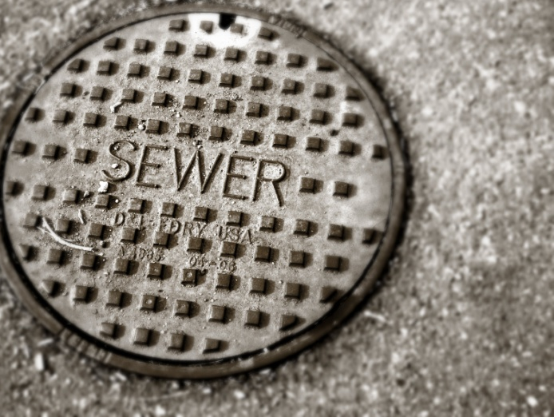
Sewer Fund

Slide 47
Sewer Revenue FY 2014 to Current

Slide 48
Sewer Expenses FY 2014 to Current

Slide 49
Sewer Revenue & Expenses FY 2014 to Current

Slide 50
Department 50: Sewer FY 2024: Contractual (5505)
Total: $89,510

Slide 51
Department 50: Sewer FY 2024: Operating Supplies (6110)
Total: $27,650

Slide 52
Department 50: Sewer FY 2024: Chemicals (6150)
Total: $78,500

Slide 53
Department 50: Sewer FY 2023: Repairs & Maintenance (6200)
Total: $51,250

Slide 54
Sewer Dept.: FY24 Infrastructure Projects
Project: | Source: | Cost:
Sewer Relining: Federal & DePaul St. | Town | $125,000
Creamery Road Pump Station Replacement | USDA Loan: $1,987,000 USDA Grant: $1,862,300 Town: $1,395,000 | $5,244,300
ChemScan Upgrade FY 23 & 24 | Town | $62,000
Smart Manhole Covers | Town | $29,050

Slide 55
Project Cost Creamery Road Pump Station Replacement Town of Emmitsburg, As of 04/05/2023
Item: | Description: | Cost:
Development | Per RK&K estimate 03/14/2023 with contingency & BABAA Markup | $ 4,392,400.00
Administrative | Town public advertising, copies, etc. | $ 15,000.00
Legal Services | Town fees, per contingency transfer on account summary | $ 19,650.00
Interim Financing | Fees per proposal 12/21/2022 | $ 3,500.00
Bond Council | Per engagement letter from Dec. 2022 | $ 11,500.00
Potomac Edison | Electric service work per RK&K obtained estimate | $ 15,000.00
Engineering PER/ER | Spent per town account summary | $ 49,330.15
Engineer Design & Bidding |  | $ 137,496.85
Engineer Construction and Post-Construction Admin. | Per fee amendment 4 & 5, for 450 days with BABAA | $ 67,518.00
Engineering Inspections | Full-time RPR. Per fee amendment 4 | $ 269,340.75
Contingencies |  | $ 263,264.25
 |  | Total $5,244,300.00

Slide 56
Sewer Dept.: Update to Current Infrastructure Project
Creamery Road Pump Station Board approved construction company May 1, 2023. Awaiting USDA Authorization to Proceed to construction. Anticipate breaking ground in June/July 2023. Cost estimate has increased by $800,000 due to increases in material pricing. Time for construction has increased from 365 days to 450 days due to supply chain issues.

Slide 57
Sewer Dept.: Future Capital Improvement Projects
Project: | Time Frame:
Sewer Relining: various lines, including W. Main St. & Tannery Dr. | FY 24-28
Additional Smart Manhole Covers | FY 24-28
Lagoon Liner Replacement | FY 24-28
Heating System and/ or Addition at WWTP | FY 24-26

Slide 58
Other Budget Items

Slide 59
Pool Revenue to Date
*pre-covid
*covid

Slide 60
Electric Budget FY 2020 to FY 2024

Slide 61
Town Energy Expenses
 | A | B | C | Total
FY | Potomac Edison Expense | *UGI Solar kWh Expense | First Energy kWh Refund | FY Energy Cost (A + B – C)
11 | $164,300 |  |  | $164,300
12 | $146,800 |  |  | $146,800
13 | $126,400 |  |  | $126,400
14 | $128,500 |  |  | $128,500
15 | $63,700 | $143,300 | ($70,200) | $136,800
16 | $68,000 | $228,200 | ($94,100) | $202,100
17 | $21,900 | $236,100 | ($92,400) | $165,600
18 | $23,700 | $203,600 | ($69,800) | $157,500
19 | $48,400 | $161,800 | ($30,100) | $180,100
20 | $27,100 | $246,200 | ($81,600) | $191,700
21 | $23,000 | $244,000 | ($92,000) | $175,000
22 | $35,000 | $212,000 | ($71,500) | $175,500
*23 | $23,200 | $109,200 | ($45,400) | $87,000
*Note: July 2022 to December 2022

Slide 62
Town Energy Expenses
Notes:
Highlights
Starting FY15 Potomac Edison invoices down 50%
Kwh usage with variable rates no longer applies
Kwh rates fixed to assist in proper budgeting
Certain line item charges no longer apply to Town

Slide 63
Insurance FY 2020 to FY 2024 Note: Includes Property, General Liability, Auto

Slide 64
Debt Obligations As of June 30, 2022
Purpose: | Original: | Principle: | Annual Payment:
2005 MWQFA, Mt View Water Line | $375,000 | $43,477 | $21,609
2006 MWQFA, South Seton Water Line | $432,762 | $98,500 | $24,222
2009 Fulton Bank, Lincoln Avenue Water Line | $801,500 | $242,655 | $43,100
2014 USDA, New Wastewater Treatment Plant | $5.4 M | $4.74M | $99,480
2016 USDA, New Wastewater Treatment Plant | $258,000 | $230,310 | $5,262

Slide 65
Water Fund - Depreciation
FY 12 | FY 13 | FY 14 | FY 15 | FY 16 | FY 17 | FY 18 | FY 19 | FY 20 | FY 21
$6.33M | $6.24M | $6.56M | $6.54M | $6.44M | $6.34M | $6.34M | $6.18M | 6.02M | 5.93M
152,478 | 151,580 | 152,432 | 153,247 | 151,772 | 153,122 | 158,071 | 161,154 | 160,905 | 163,415
FY 22
6.13M
165,244

Slide 66
Sewer Fund - Depreciation
FY 12 | FY 13 | FY 14 | FY 15 | FY 16 | FY 17 | FY 18 | FY 19 | FY 20 | FY 21
9.78 M | 10.86 M | 17.65 M | 21.59 M | 21.65 M | 21.28 M | 21.16 M | 20.85 M | 20.53M | 20.35M
312,586 | 311,623 | 313,094 | 308,545 | 486,492 | 664,874 | 667,794 | 671,741 | 675,260 | 679,576
FY 22
20.24M
684,039

Slide 67
Remaining Sewer & Water Taps
 | Sewer | Water
CURRENT | 1,194 | 228
Rutter’s | -12 | -12
Brookfield 19 homes on Irishtown | -19 | -19
55 Second Avenue (new home) | -1 | -1
101 W Main St – New Apartment | -1 | -1
Village Liquors | -2 | -2
Southgate 3 homes | -3 | -3
Ripleigh’s Creamery | -2 | -2
Federal Stone | -5 | -5
Warthen’s Court 5 homes | -5 | -5
Brookfield 10 homes on Gabe’s Court | -10 | -10
REMAINING | 1,134 | 168
taps paid and allocated
taps not yet purchased
lots not yet approved
Sewer taps = [(state permitted maximum usage - 5-year average usage) / 250]
Water taps = [(state permitted maximum usage – 3-year average usage) / 250]
*In order to use well J & 7, we will need to build the Emmit Garden’s water treatment plant.
Estimated to cost well over $2,000,000. This will result in 468 more water taps.

Slide 68
Projects Completed: FY 2023
This Photo by Unknown Author is licensed under CC BY

Slide 69
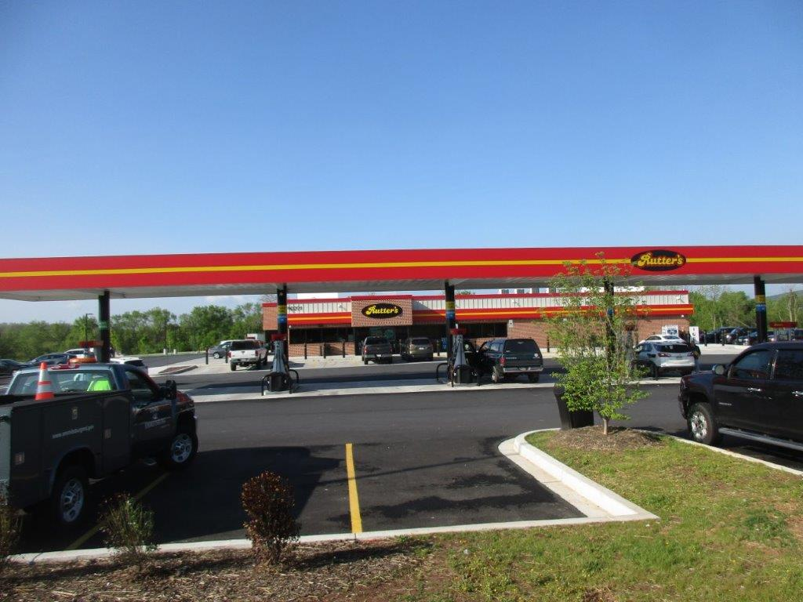
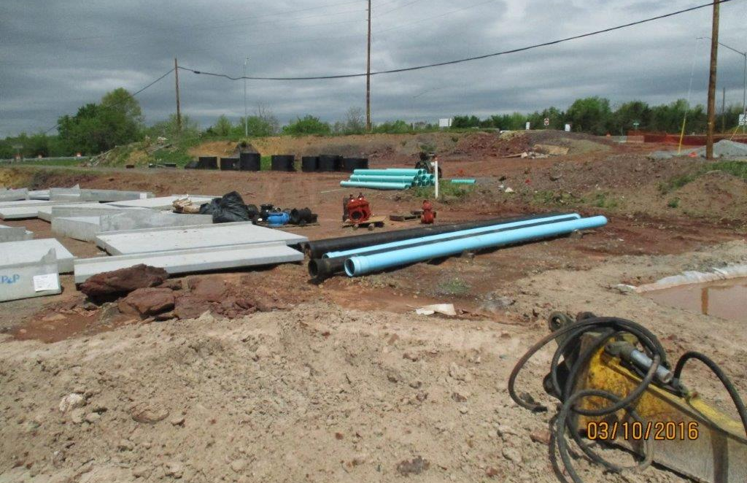
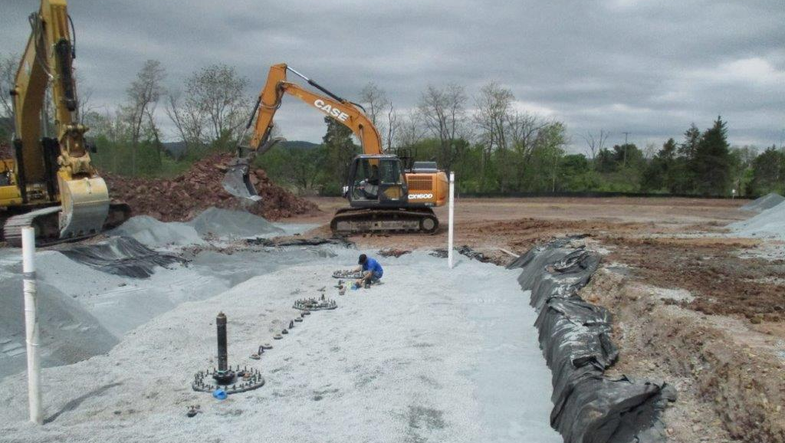
Rutters Opening

Slide 70
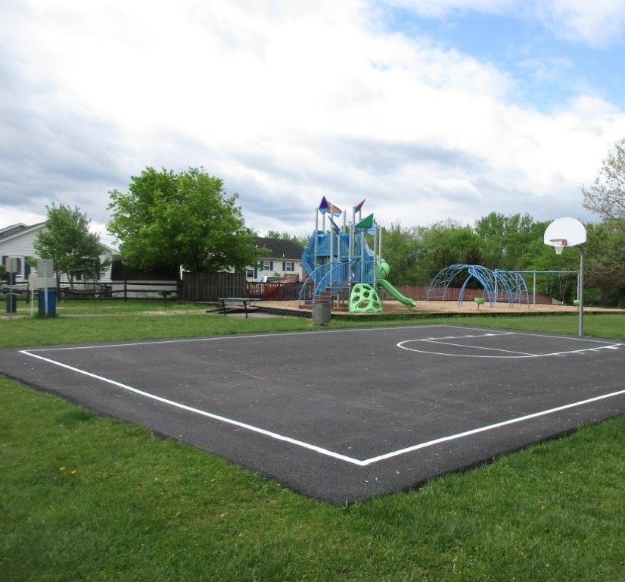
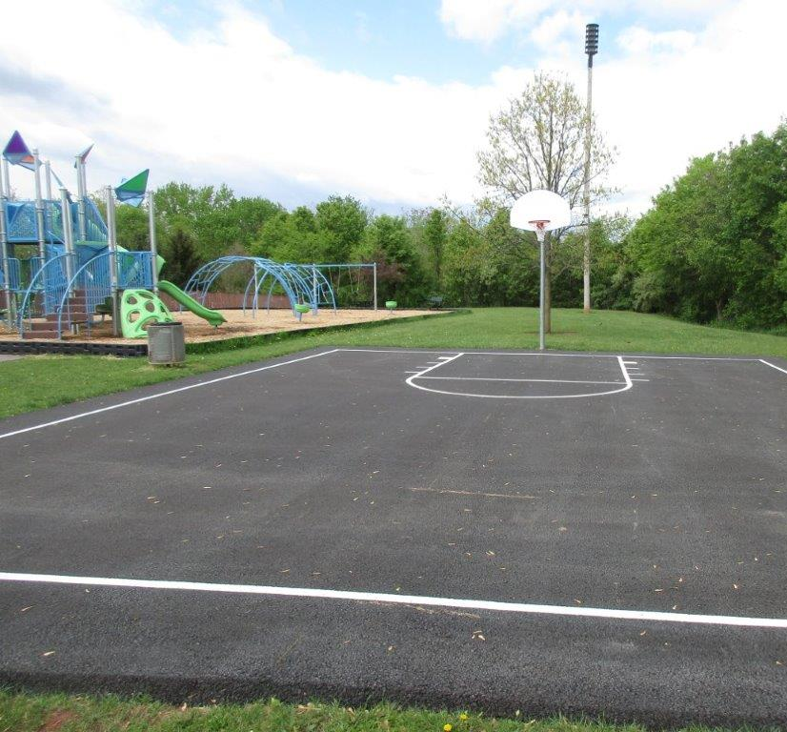
Silo Hill Park Playground

Slide 71
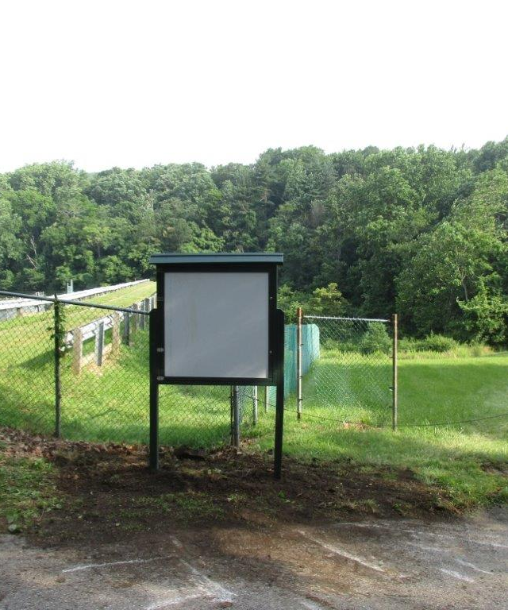
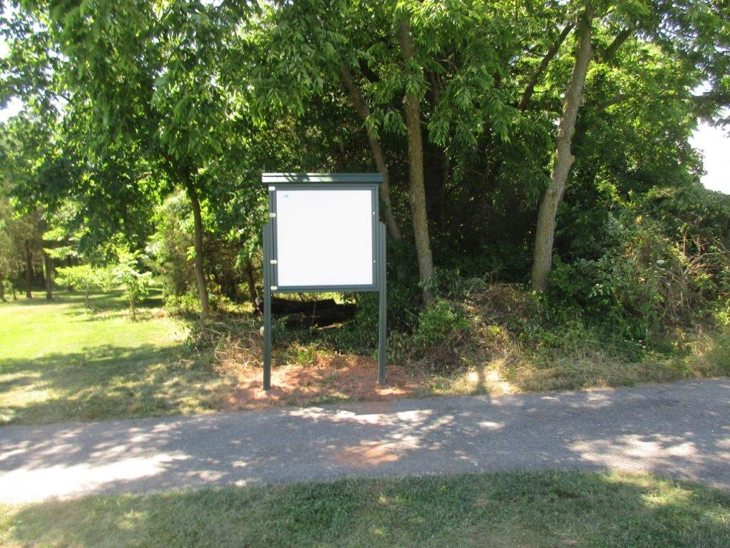
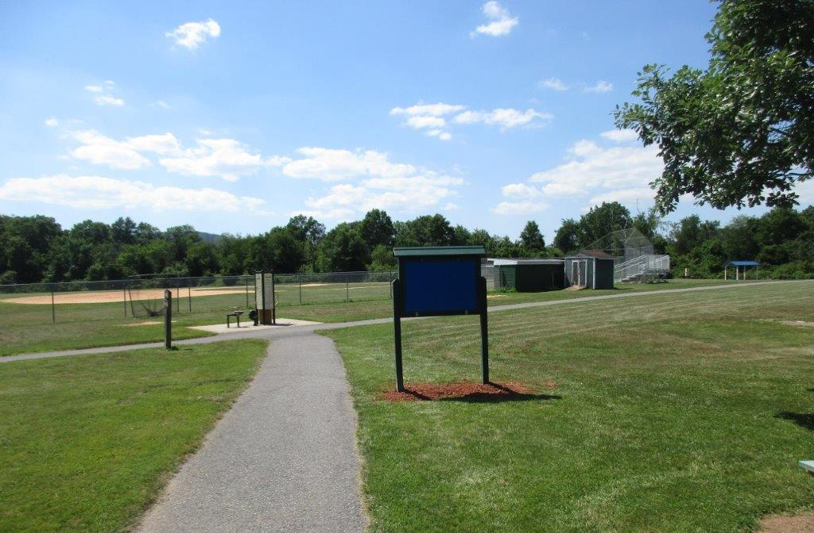
New Message Boards
Location: Rainbow Lake
Location: By Community Park Stock Pile
Location: Ballfield #7

Slide 72
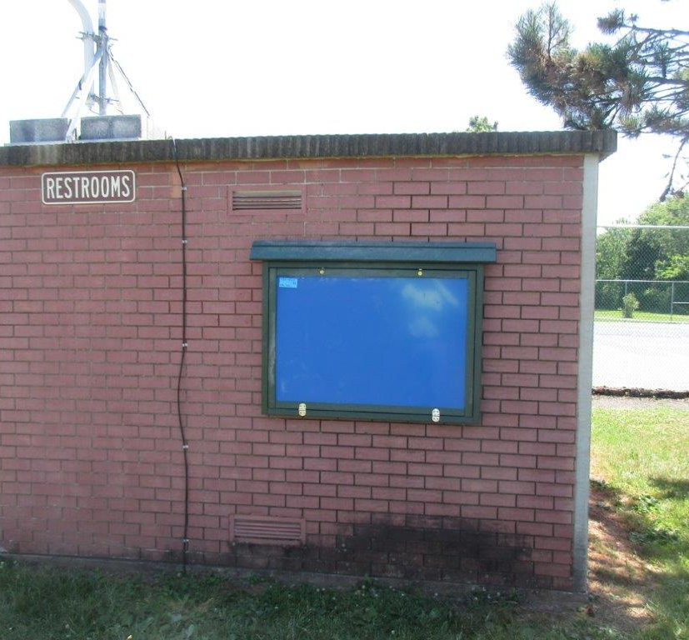
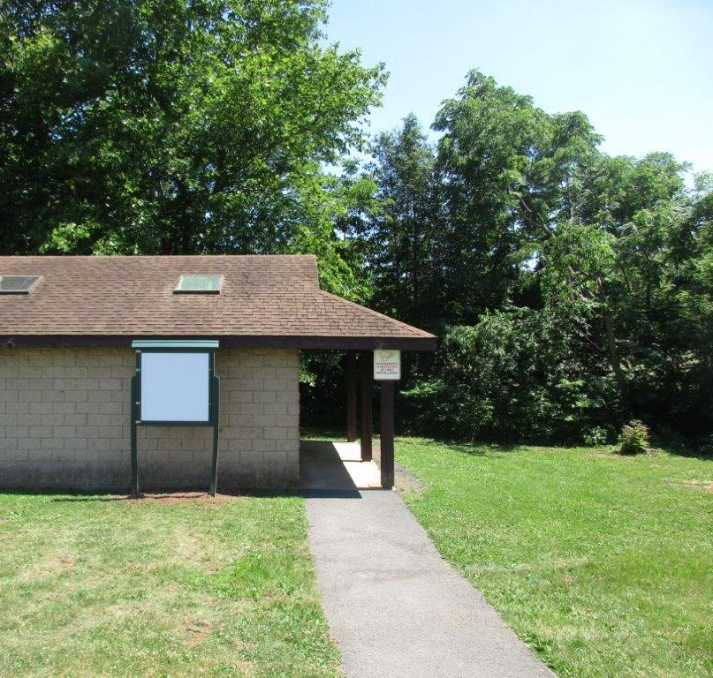
New Message Boards
Location: Community Park Restroom
Location: Memorial Park Restroom

Slide 73
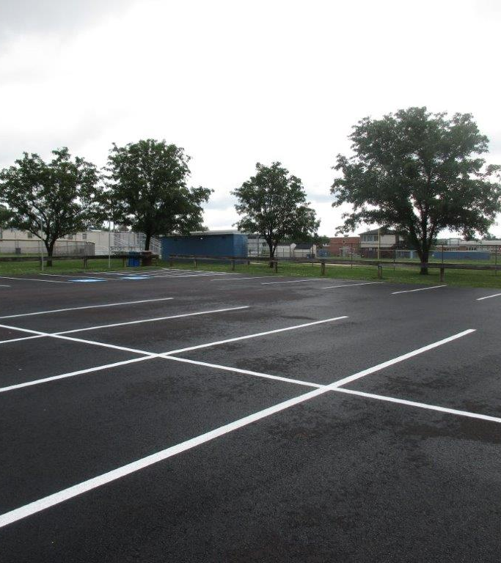
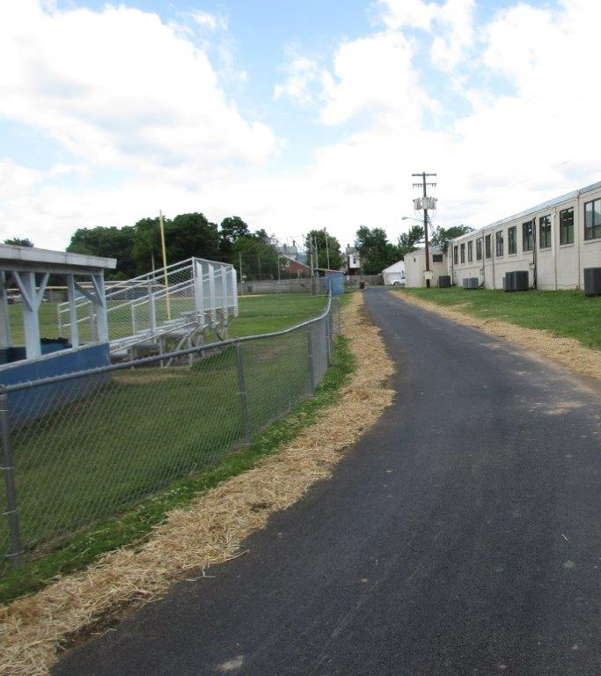
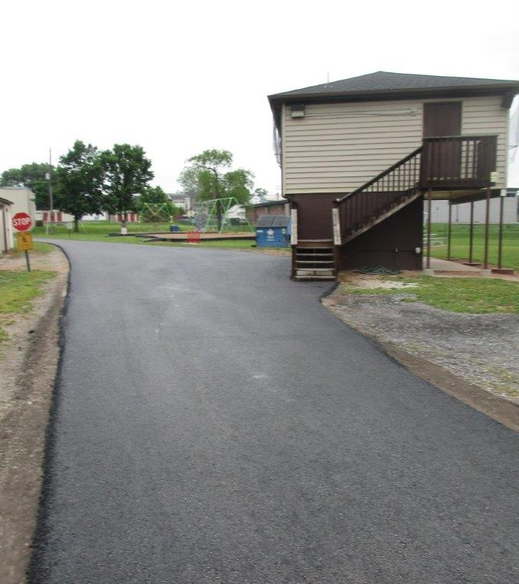
Memorial Park Paving Project

Slide 74
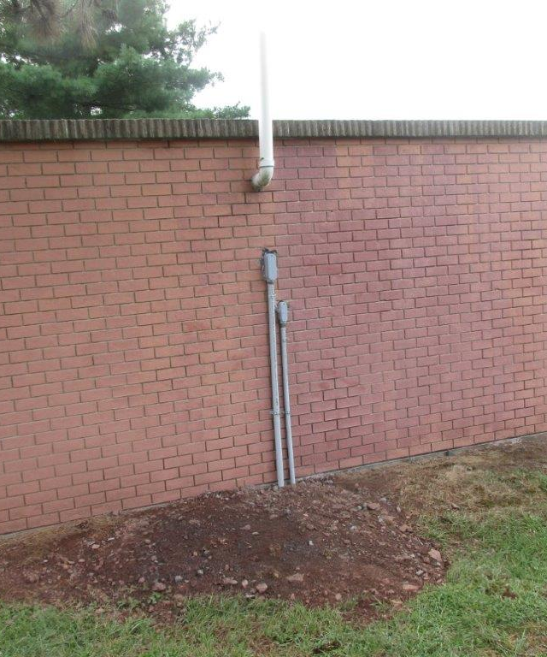
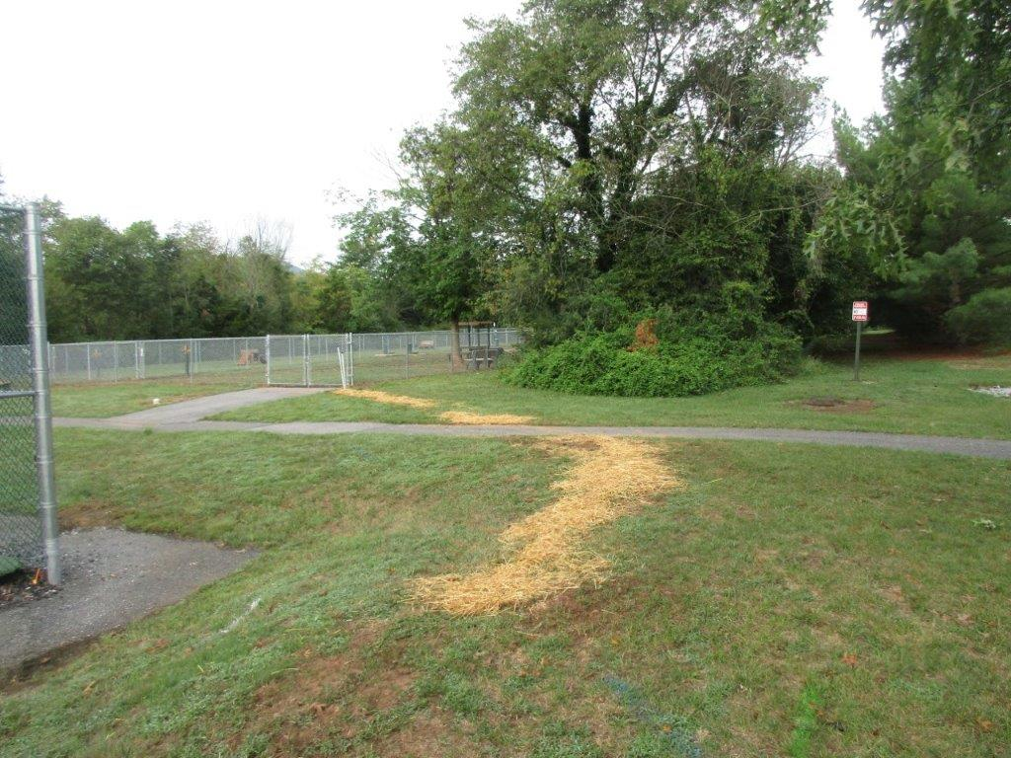
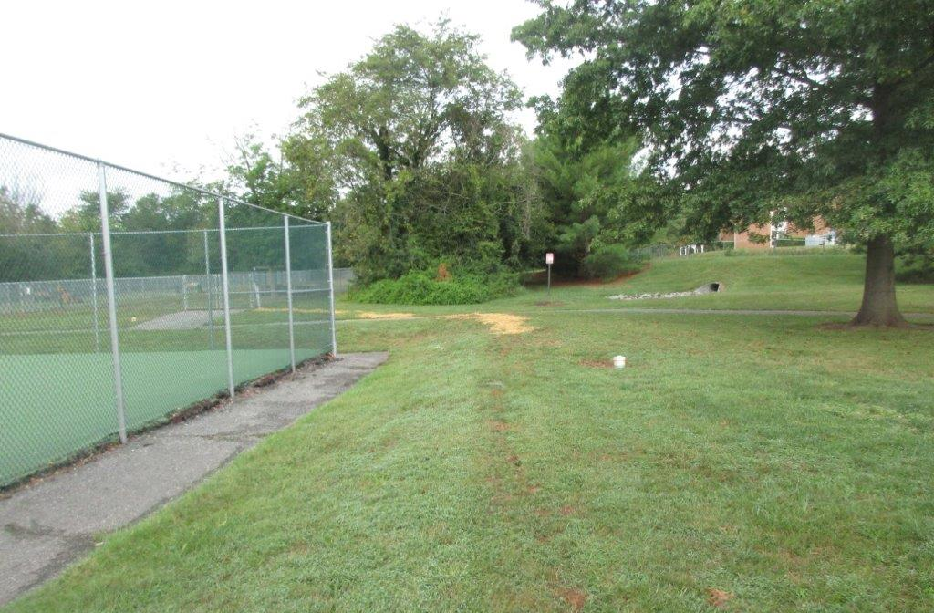
Camera Project at E. Eugene Myers Dog Park

Slide 75
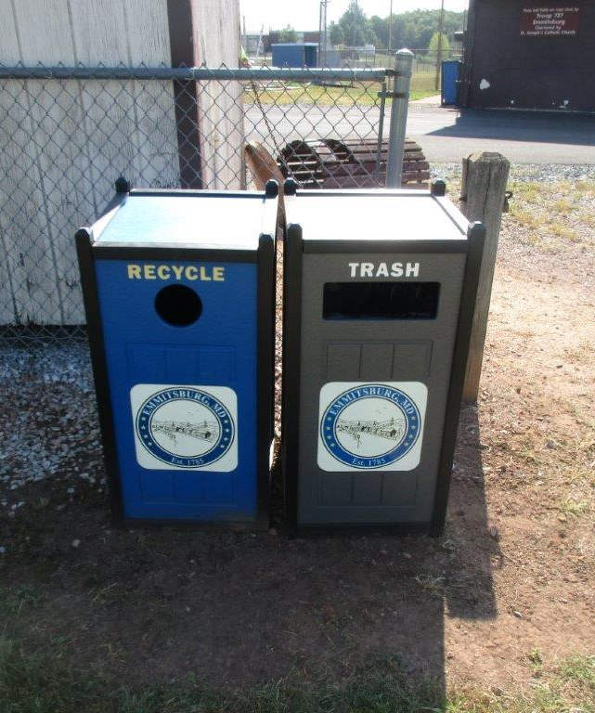
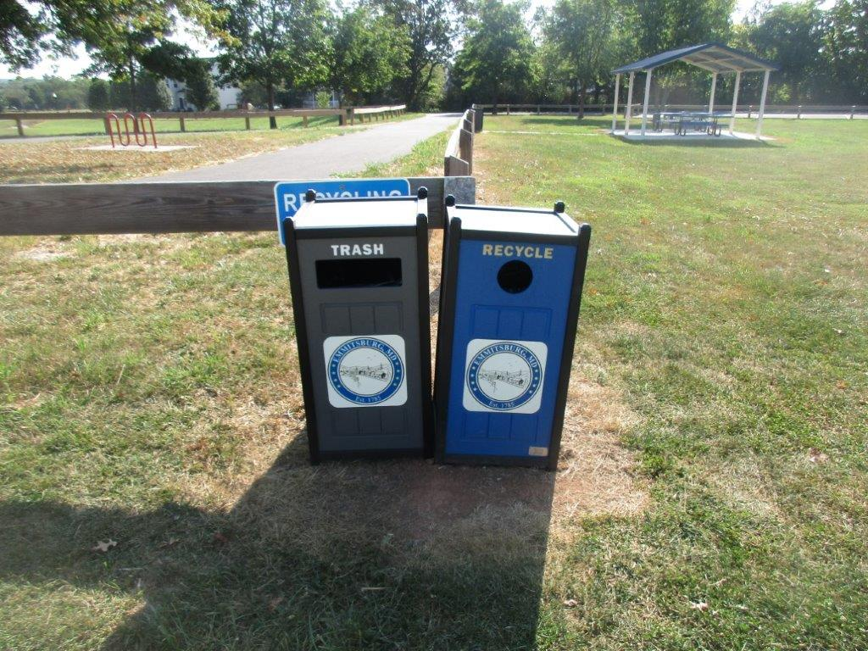
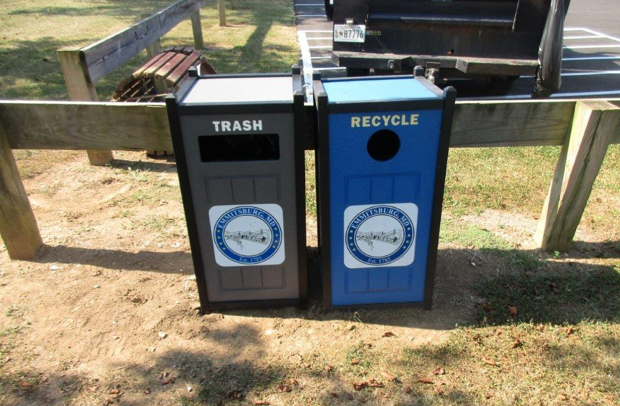
Location: Ballfield #6 in
Memorial Park
Location: Ballfield #3 in E. Eugene Myers Park
New Park Trash Cans & Recycling Bins
Location: Memorial Park Parking Lot

Slide 76
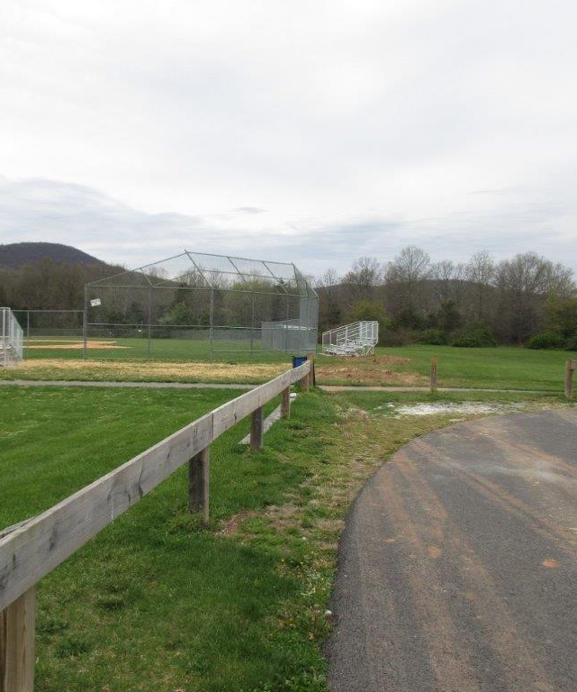
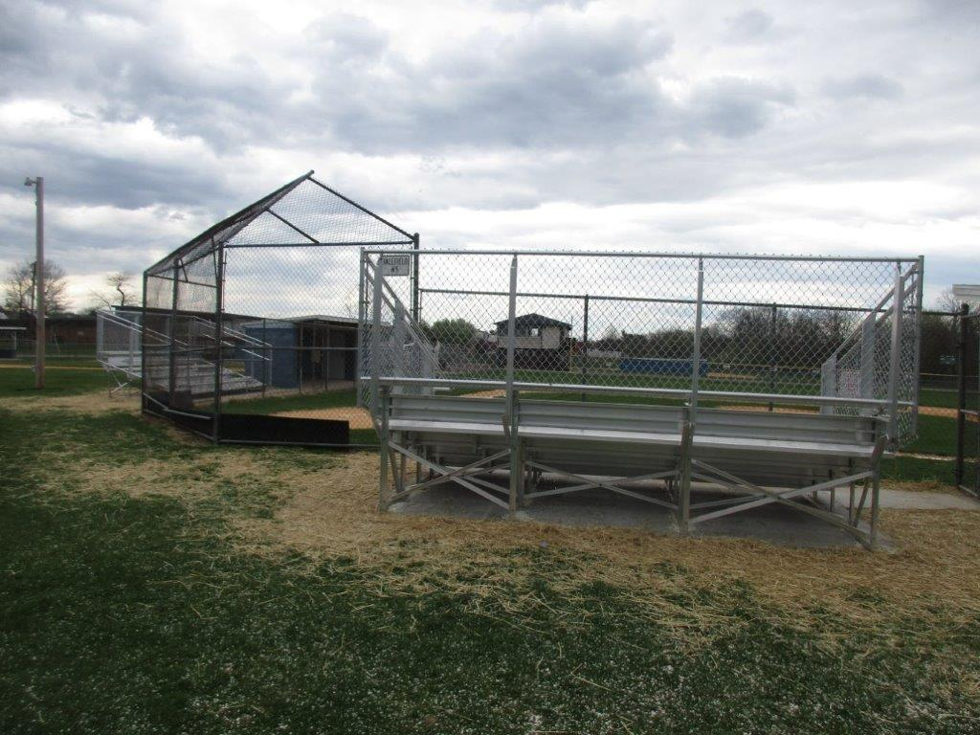
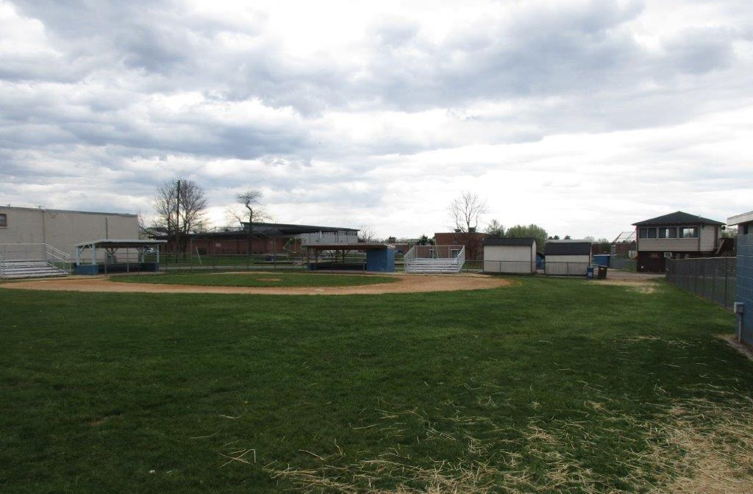
Parks Bleacher Project

Slide 77
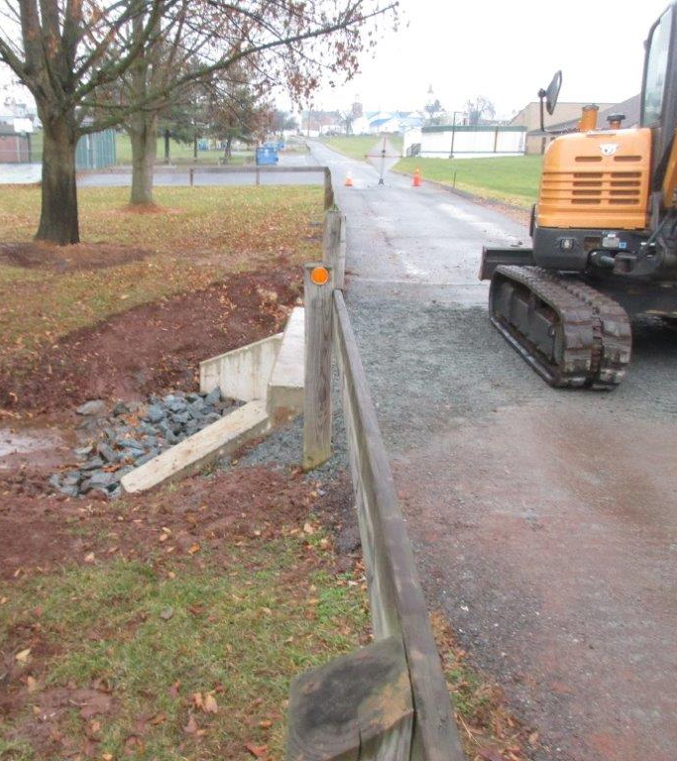
E. Eugene Myers Park Storm Drain Project

Slide 78
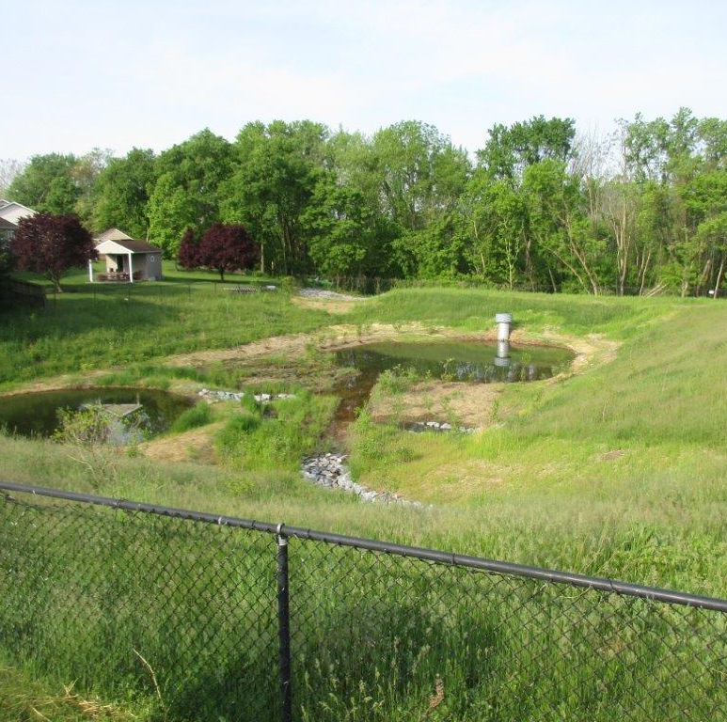
Silo Hill Catch Basin Project

Slide 79
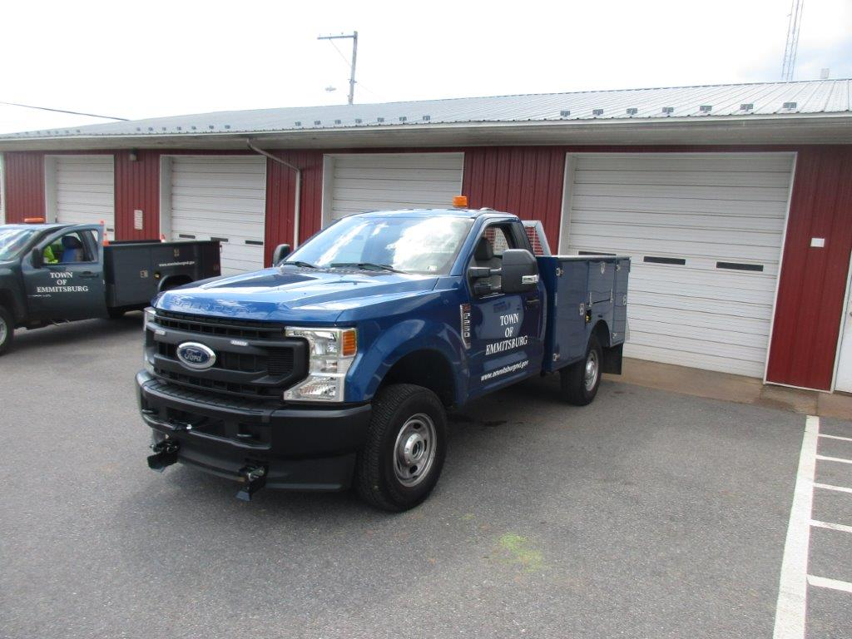
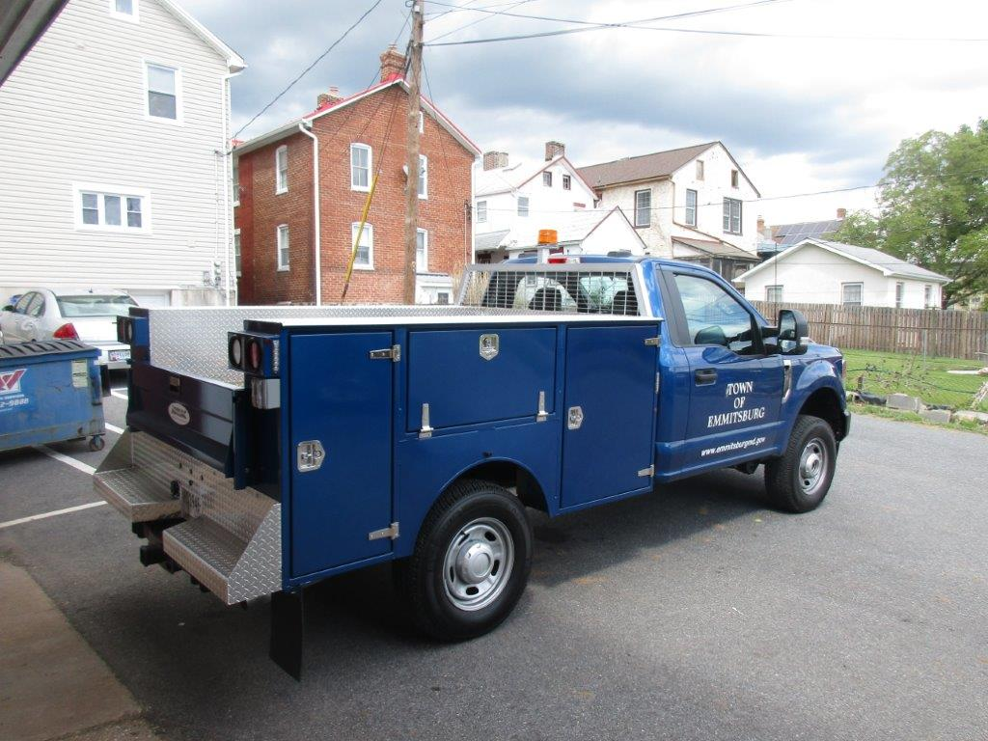
New Vehicle 2022 Ford F250 4X4

Slide 80
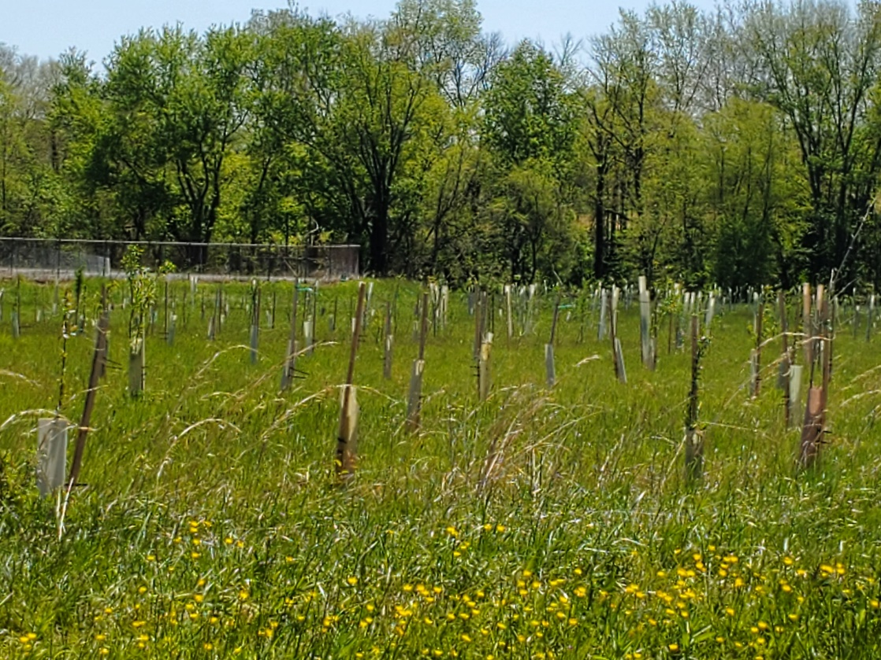
Tree Plantings
Recertified 5th Year
Tree City USA Town

Slide 81
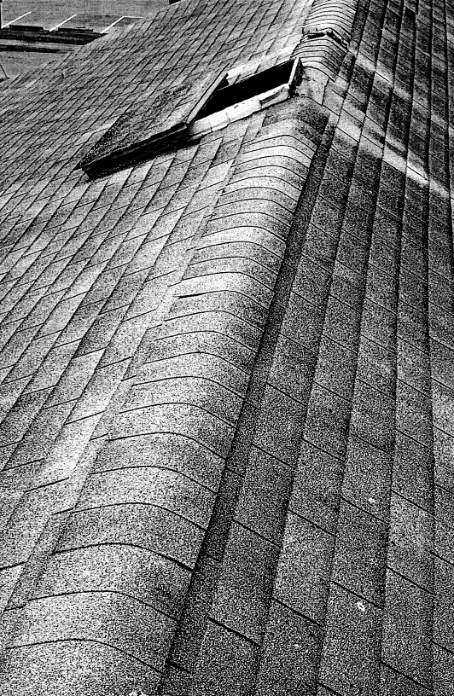
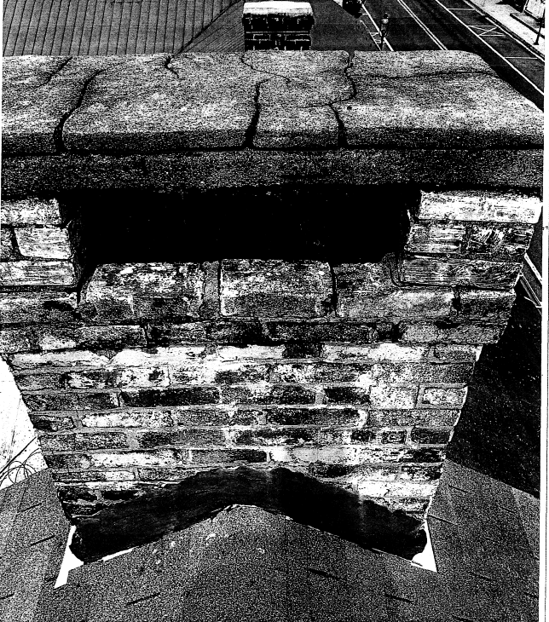
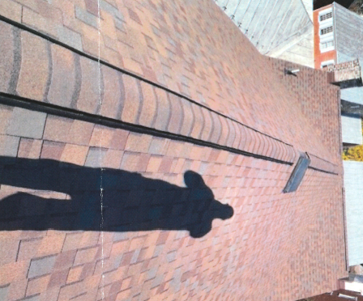
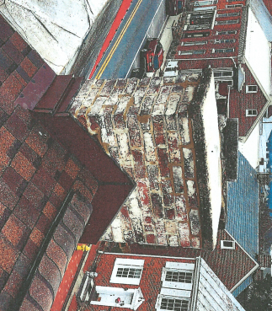
Community Legacy Grant at 106 E Main St.
BEFORE
BEFORE
AFTER
AFTER

Slide 82
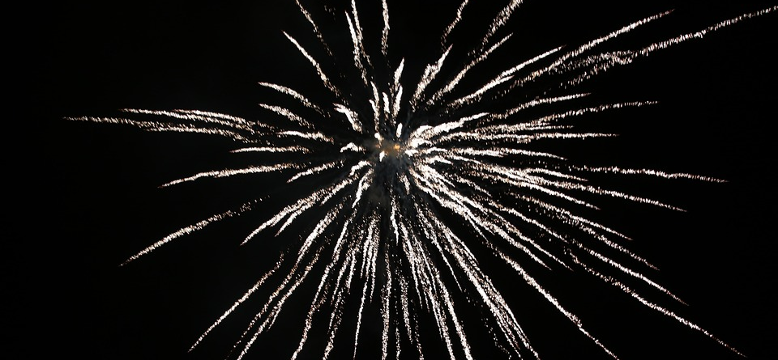
Town Events: FY2023

Slide 83
Farmers Market
Farmer’s Market hours have changed and now are open from 2pm – 8pm.
Food Trucks and alcohol tasting
Activities for the children.
Variety farmers from fresh produce, to meat and eggs, and baked goods.
Variety of vendors including Scentsy, hand made crafts, and more.

Slide 84
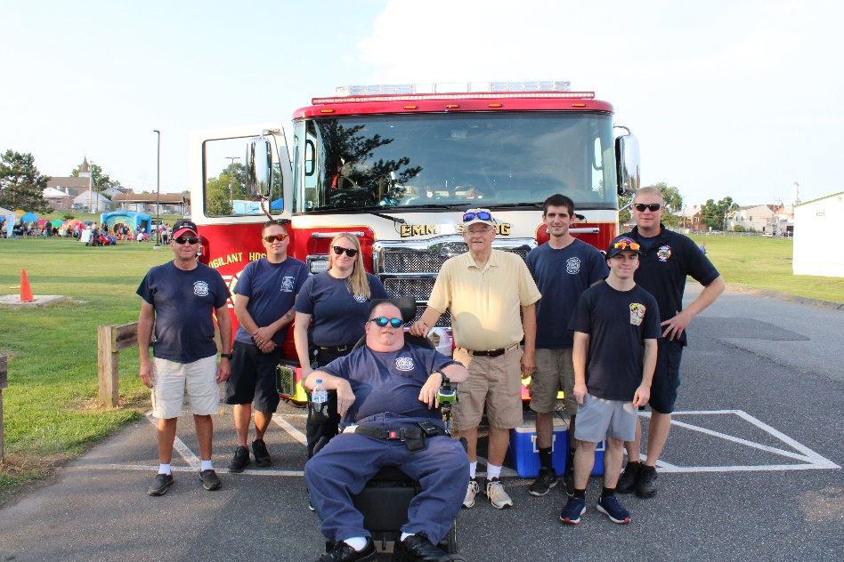
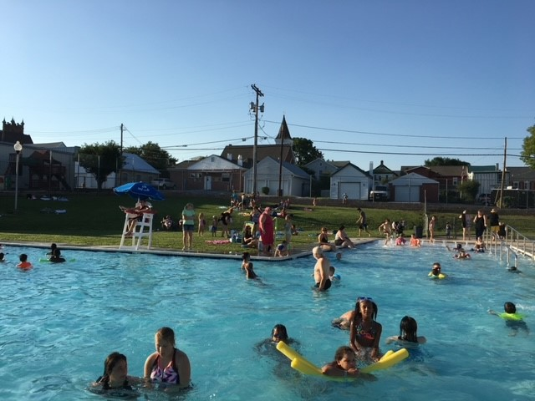
National Night Out
Pool Parties

Slide 85
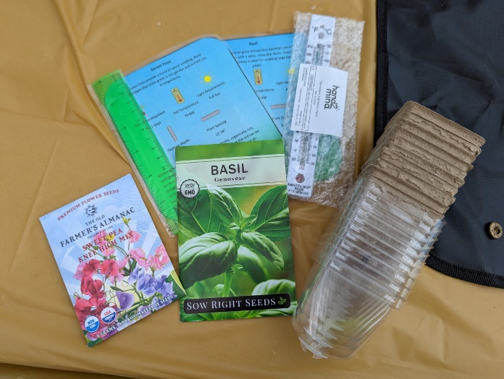
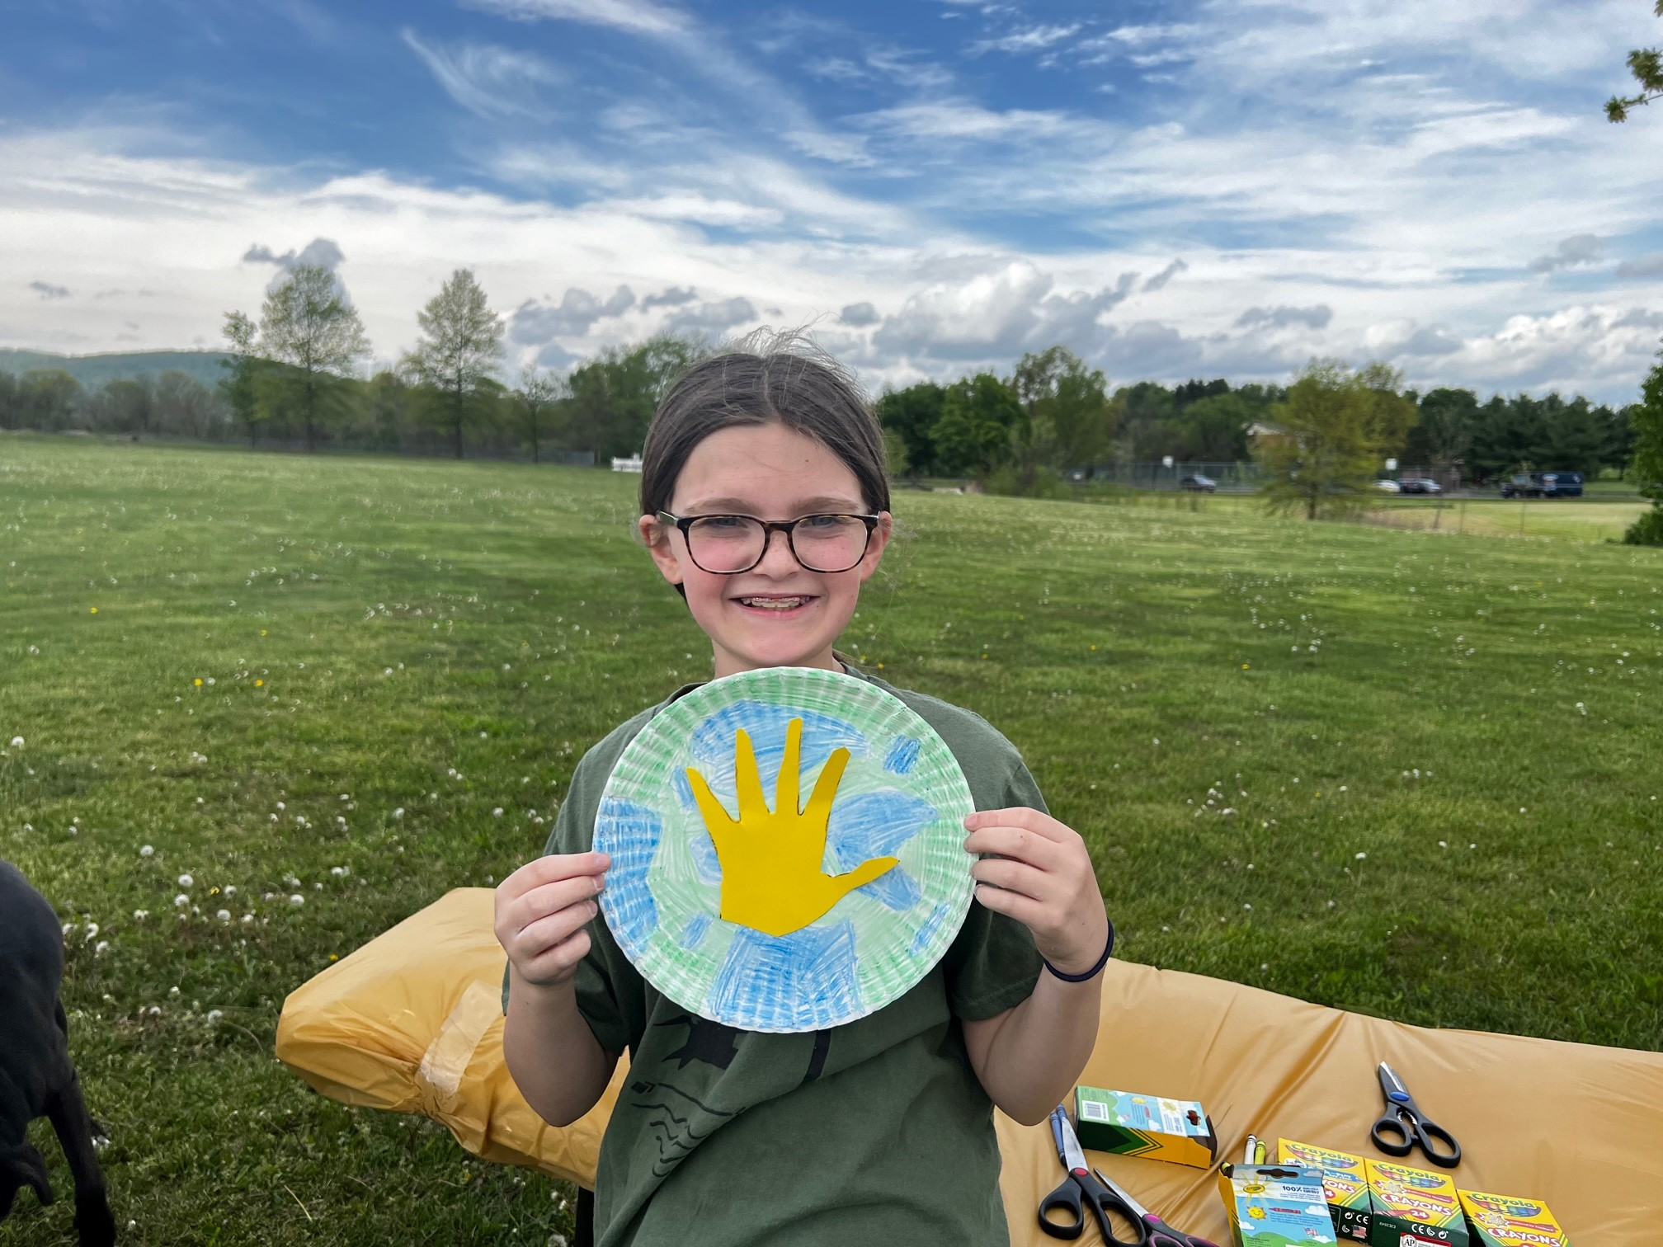
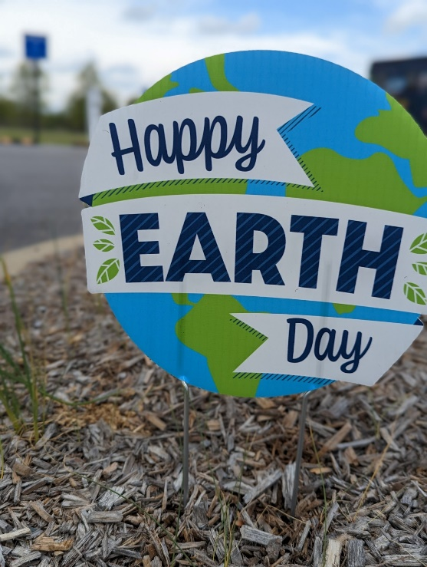
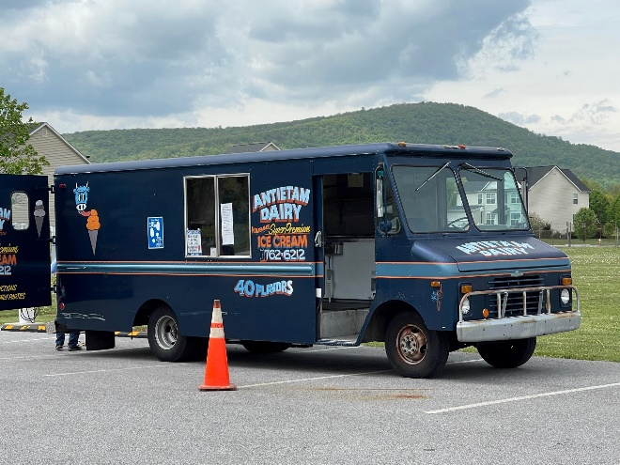
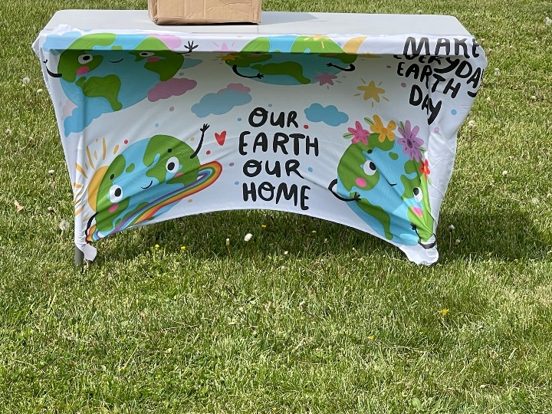
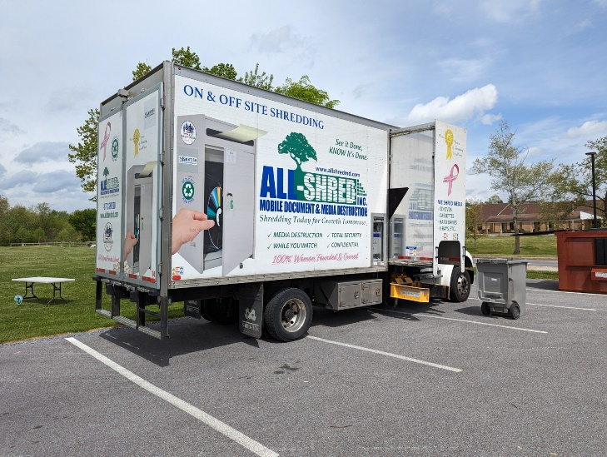
Earth Day 2023

Slide 86
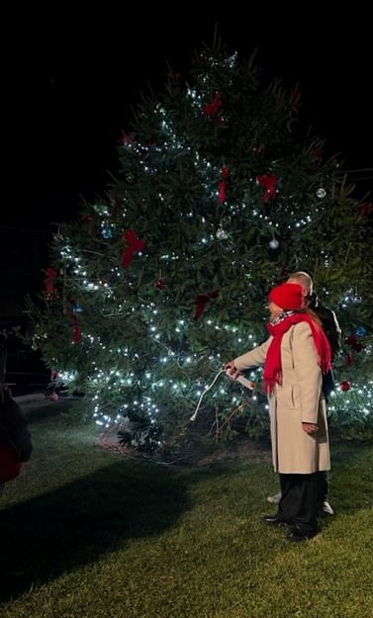
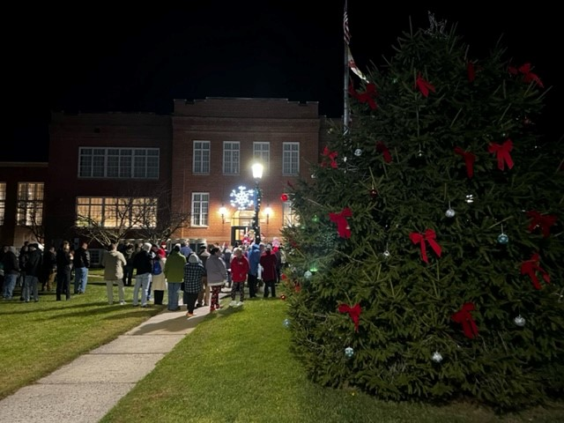
Christmas Tree Lighting

Slide 87
Grants Applied For In FY 2022
Agency: | Project: | Amount: | Y/N:
USDA | New Public Works Equipment | $157,000
Clean Up & Green Up | Trash Containers & Arbor Day | $5,000
MD DHCD | Emmitsburg Façade Restoration | $50,000
WHAA | St. Euphemia’s School Panel | $3,547
Office of Criminal Control | Advanced License Plate Readers | $98,544
POS | Restroom & Concession Stand | $147,980
LPPI | Restroom & Concession Stand | $40,000
DHCD CL | Restroom & Concession Stand | $89,020
LPPI | Memorial Park Paving | $58,000
LPPI | Message Centers | $7,500
LPPI | Bleacher Replacement | $73,300
Office of Criminal Control | State Aid for Police Protection | $17,076
Visit Frederick County | Main Street Communities Fund | $10,000

Slide 88
Grants Applied For In FY 2023 *Continued..
Grant Number: | Name: | Amount: | Status:
23-1 | TRIPP Historic Walking Tour and Visit Emmitsburg Website | $9,750.00 | Approved
23-3 | TRIPP Emmitsburg Advertising Grant | $1,963.00 | Approved
23-4 | CP&P Silo Hill Playground Improvements | $146,263.00 | Approved
23-5 | POS Rainbow Lake Parking Lot | $70,000.00 | Approved
23-6 | POS Community Park Cornhole | $6,000.00 | Approved
23-7 | POS Outdoor Storybook Trail | $8,250.00 | Approved
23-8 | MEA SOLE FY23 Downtown Streetlights | $27,500.00 | Approved
23-10 | USDA Downtown Streetlight Replacement | $75,000.00 | Approved
23-11 | USDA Downtown Streetlight Replacement Additional Funds | $50,000.00 | Approved

Slide 89
Grants Applied For In FY 2023 *Continued...
Grant Number: | Name: | Amount: | Status:
23-12 | DHCD Business District Safety Project | $85,000.00 | Approved
23-13 | LPPI Rainbow Lake Parking Lot | $44,500.00 | Approved
 | MEA SOLE FY23 Neighborhood Streetlights | $46,000.00 | Approved, did not pursue
 | MDE DePaul Street Waterline Replacement | $1,110,000.00 | Pending
 | MDE North Seton Avenue Waterline Replacement | $1,145,552.00 | Pending
23-17 | DHCD Operating Assistance Grant – MIP | $10,000.00 | Approved
23-4 | LPPI Community Park Pavilion Improvements | $22,000.00 | Approved

Slide 90
Grants Applied For In FY 2023
Grant Number: | Name: | Amount: | Status:
23-15 | LPPI Memorial Park Pavilion Improvements | $22,000.00 | Approved
23-16 | LPPI Baseball Bat/Helmet Racks | $3,000.00 | Approved
 | CP&P Half Basketball Court Memorial Park | $15,000.00 | Denied
 | CP&P Timber Stacks Memorial Park | $105,686.00 | Denied
 | KMB Pet Waste Stations and Recycling Containers | $5,000.00 | Denied
 | MDE Emmitsburg Transmission Main Replacement | $5,865,000.00 | Pending
Total Applied For: $8,881,964.00

Slide 91
Future Grants For FY 2024
Community Legacy FY24 - $50,000
Operating Assistance Grant – Main Street Improvement Program $10,000 (due May 2024)
Program Open Space – TBD (due May 2024)
Community Parks & Playground – TBD (due August 2023)
Tourism Reinvestment in Promotion & Product Grant – TBD (due January 2024)
Business District and Neighborhood Safety Grant – TBD (due March 2024)
Visit Frederick County Main Street Communities Cooperative Fund – TBD (due January 2024)
Governor’s Office of Crime Prevention – TBD (due September 2024)
**And other grants as needs arise and they are discovered

Slide 92
Discussion – Questions?
This Photo by Unknown Author is licensed under CC BY-NC-ND

